Slide 1

The Combination of Selective Electrodialysis and Bipolar Membrane Electrodialysis to Process Rejected Brine and Absorb CO₂
Speaker: Ni Yuqin
22 NOV 2024

Slide 2
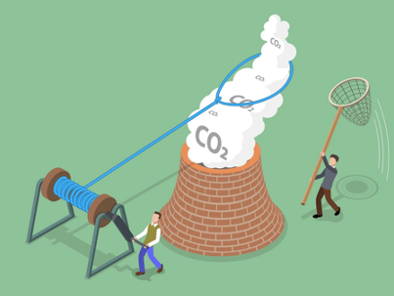
CONTENT
Background
Experimental Setup
Treatment in SED
Valorization through BMED
Economic Analysis
Notes:
My presentation will be divided into these parts. Firstly I will give the background of the research. Then I will talk about the setup used in two experiments. Then I will go deeply into these two systems and discuss the influence of operational parameters on final result. Finally, the economic analysis is given.

Slide 3
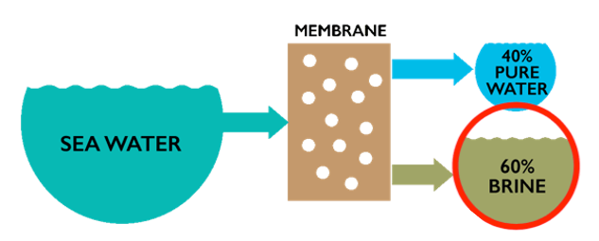
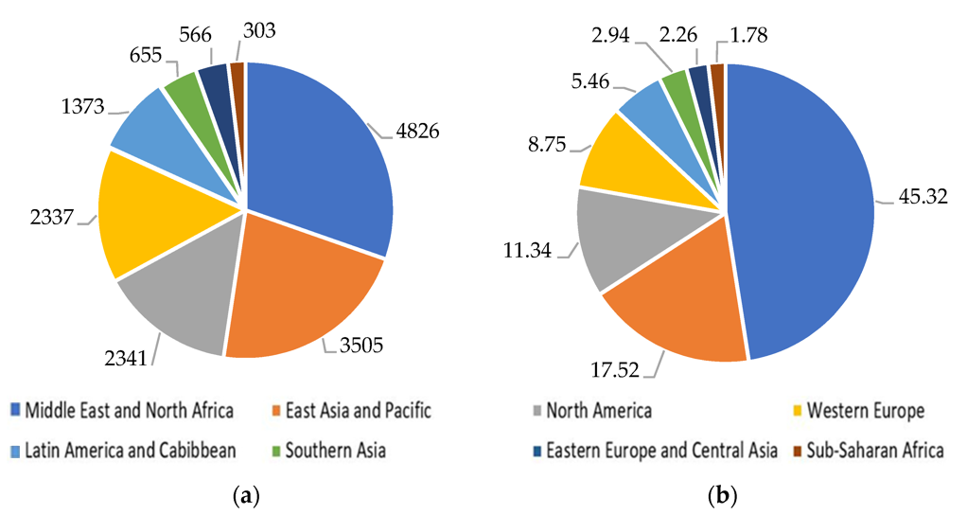

Background —— Existing problems
Table. CO₂ emission in different processes
1 L
Process | CO₂ Emission[kg/m³]
Reverse Osmosis | 1.75-2.79
multiple-effect distillation | 7.01–17.6
multi-stage flash processes | 9.41–25.0
1.5 L
(a)
(b)
15,846 tons of CO₂ per day
SWB?
CO₂?
Fig. Number and capacity of desalination plants by region in 2019: (a) number of desalination plants; (b) desalination capacity (million m³/day)
(Jones, E, et al, 2019; Z. Zhongming et. al, 2019; Do Thi, H. T., et al, 2021;)
Notes:
Seawater can be purified through desalination, but it poses challenges. Reject brine is a major concern. For every liter of clean water produced, about 1.5 L of reject brine is generated.
Another significant environmental contaminant resulting from the desalination process is CO2. Due to their high energy consumption, desalination facilities are frequently situated in close proximity to power plants. CO2 emissions range from 1.75 to 2.79 kg/m3 during RO.
The Middle East and North Africa had the largest regional desalination market in 2019, accounting for approximately 45% of total capacity
Given the Middle East’s extensive reliance on desalination to meet its fresh water needs, the region is particularly vulnerable to CO2 emissions from desalination facilities. In the UAE alone, multiple desalination plants produce a total of 15,846 tons of CO2 per day.
Addressing the environmental concerns related to reject brine and CO₂ emissions is crucial not only for the sustainable development of the desalination industry but also for other industries facing similar challenges

Slide 4
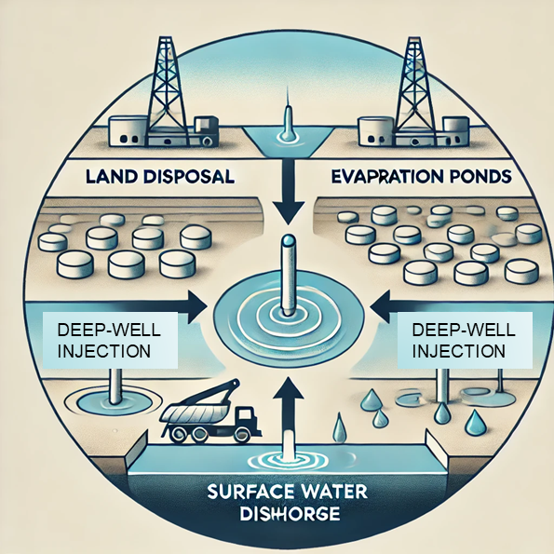
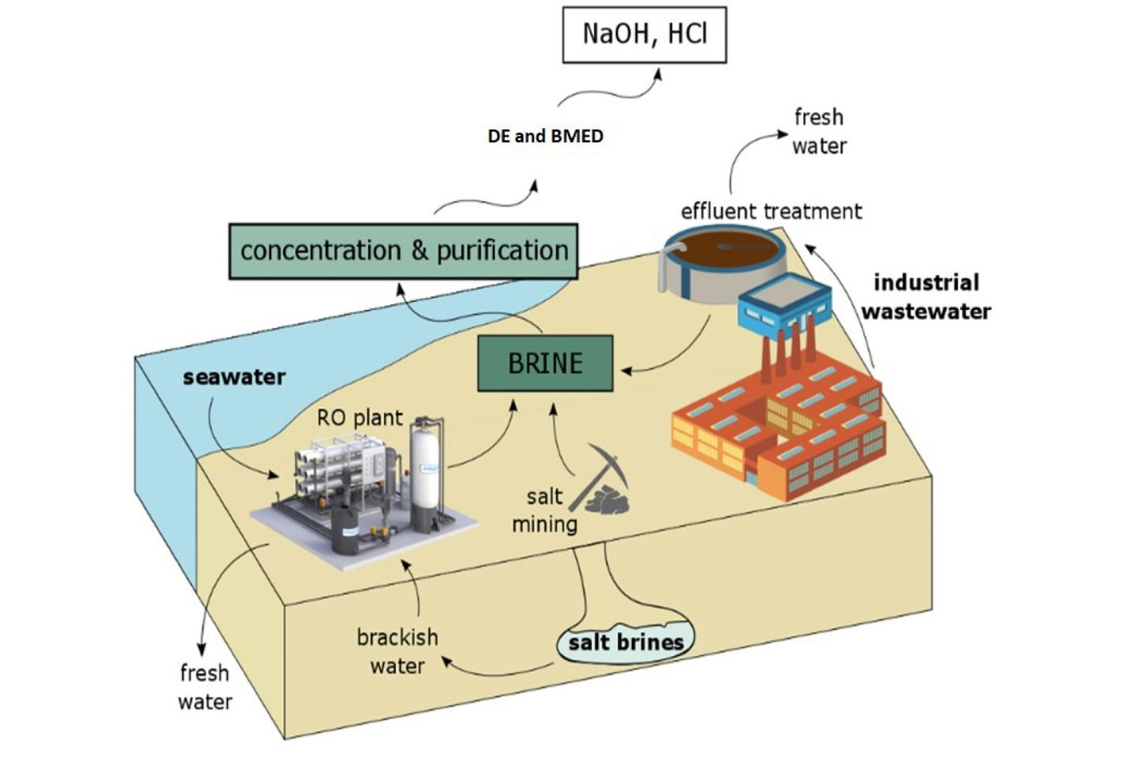
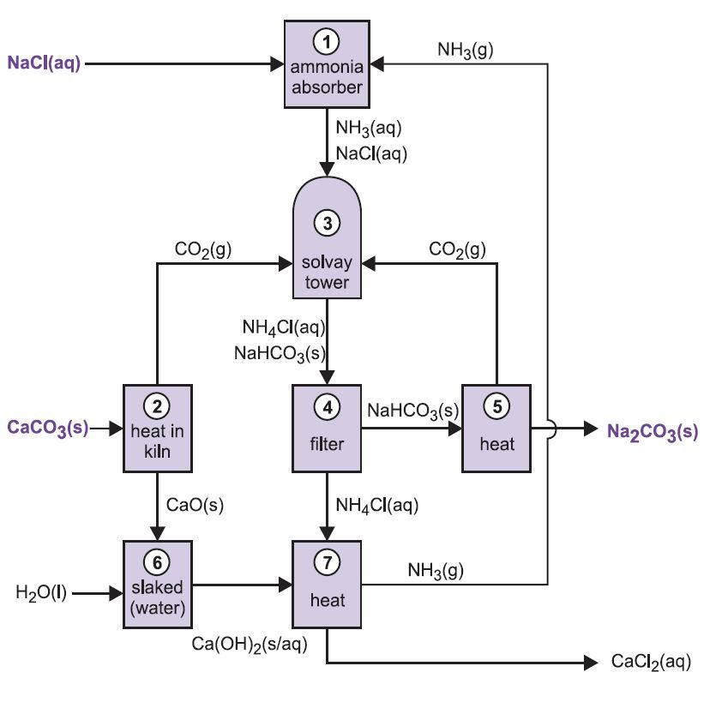
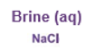
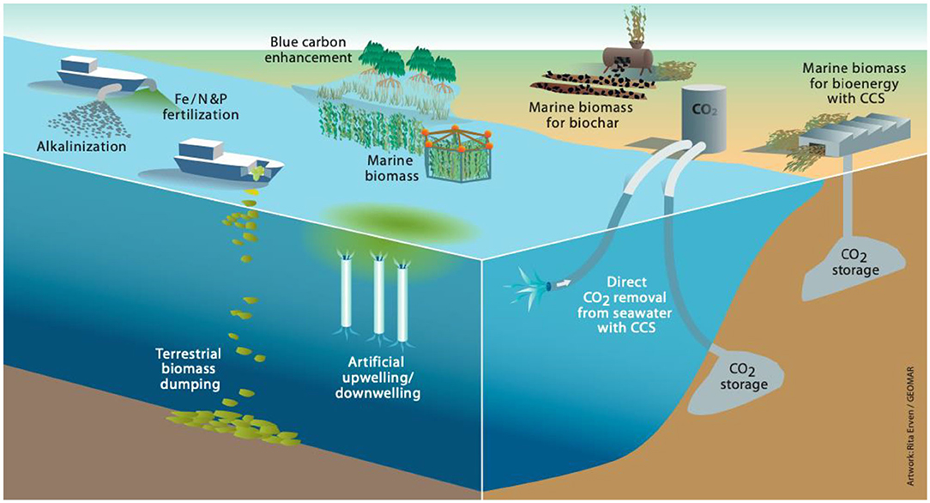
Background —— Exploring Methods
SWB Treatment
Solvay process
Brine (aq)
CO₂ Capture
Highly energy-intensive
Environmentally hazardous alkaline agents
Produces/byproducts with low purity
(Boettcher, M., 2021)
Notes:
Brine management encompasses various strategies for the efficient handling of salts. Common approaches to brine management include land disposal, evaporation ponds, deep-well injection, and surface water discharge. The industry has incorporated carbon capture, storage, and utilization approaches to reduce CO2 emissions. Currently, the most widely employed methods for capturing CO2 involve membranes, biological processes, adsorption, and absorption.
However, it is important to acknowledge that the separate handling of reject brine and CO2 poses challenges regarding cost, energy consumption, and long-term sustainability. In various industries, including desalination, both reject brine and CO2 are generated as simultaneous pollutants. Consequently, it is vital to treat them simultaneously.
it is possible to effectively manage the NaCl in reject brine by converting it into valuable products such as ammonium chloride (NH4Cl), sodium bicarbonate (NaHCO3), and sodium carbonate (Na2CO3) using the Solvay process. However, the Solvay process has several limitations. It is highly energy-intensive, involves the use of environmentally hazardous alkaline agents like ammonia, and produces byproducts with low purity, which limits their usefulness

Slide 5
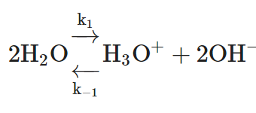
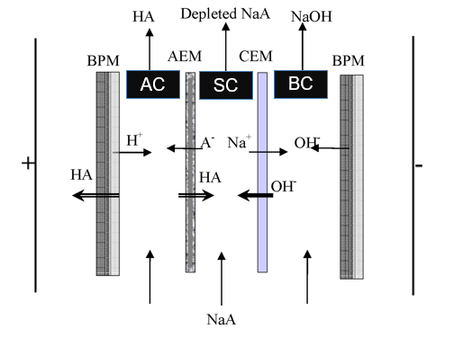
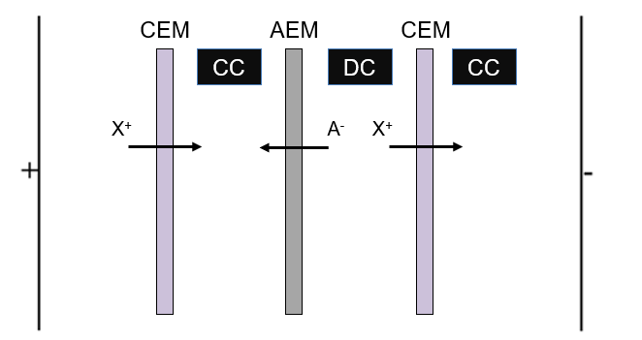
Background —— Exploring Methods
Electrodialysis Process
CO₂ capture
(a)
(b)
AC
SC
BC
XA
(a) Schematic diagram of ED. (CC: concentrate chamber; DC: dilute chamber); (b) Schematic diagram of BMED (AC: acid chamber; SC: salt chamber; BC: base chamber)
Notes:
Electrodialysis is an efficient and cost-effective method for treating brine and saltwater. Through the application of electrodialysis and its related technologies, ions are transported between solutions under an electric field, and ion exchange membranes play a vital role in facilitating this process. The creation of a potential difference in electrodialysis leads to the accumulation of ions in the concentrate chamber, while ions decreases in the dilute solution.
Bipolar membranes belong to a special class of layered ion exchange membranes, which consist of two polymer layers with fixed charges. Unlike membranes used for separation, the purpose is not to transport substances from one side to the other. Instead, the desired function involves reactions within the bipolar junction, resulting in the decomposition of water into OH− and H+. Unlike the water splitting at the electrodes during electrolysis, this reaction does not produce gas as a byproduct, nor does it consume gas.
In an electrodialysis repeating unit, bases and acids can be generated on their respective sides. Bipolar membranes can create an alkaline environment and play a vital role in electrodialysis by enabling CO2 capture.

Slide 6
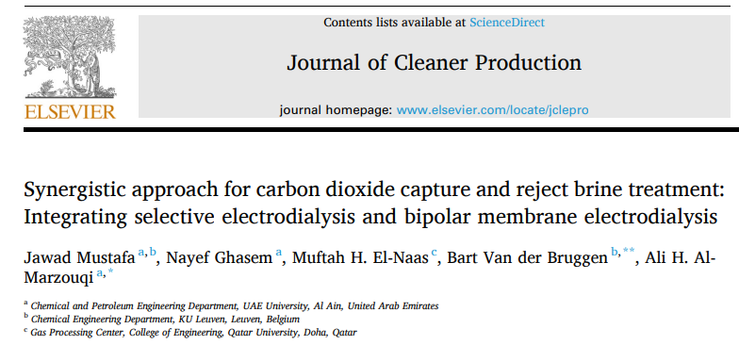
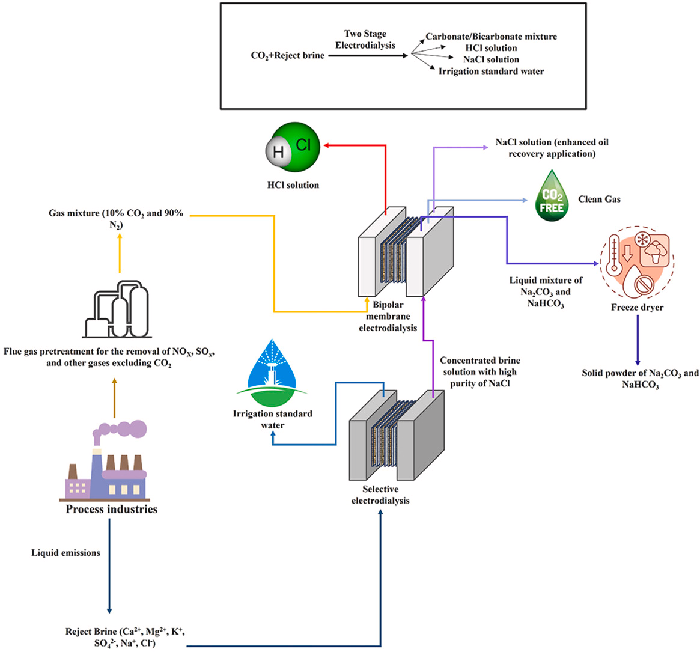


Background —— This study
Transfer CO₂ into high purity carbonates/bicarbonates
Remove scale-prone divalent ions
Notes:
The SED and BMED are integrated to simultaneously capture CO2 and treat brine at ambient conditions to produce high purity value-added products. The SED removes scale-prone divalent ions to produce a NaCl-dominated stream, while the remaining brine is suitable for irrigation. In the BMED, the NaCl-dominated stream and captured CO2 are converted into high purity carbonates/bicarbonates, HCl, and brine (93% pure NaCl)

Slide 7
CONTENT
Background
Experimental Setup
Treatment in SED
Valorization through BMED
Economic Analysis

Slide 8



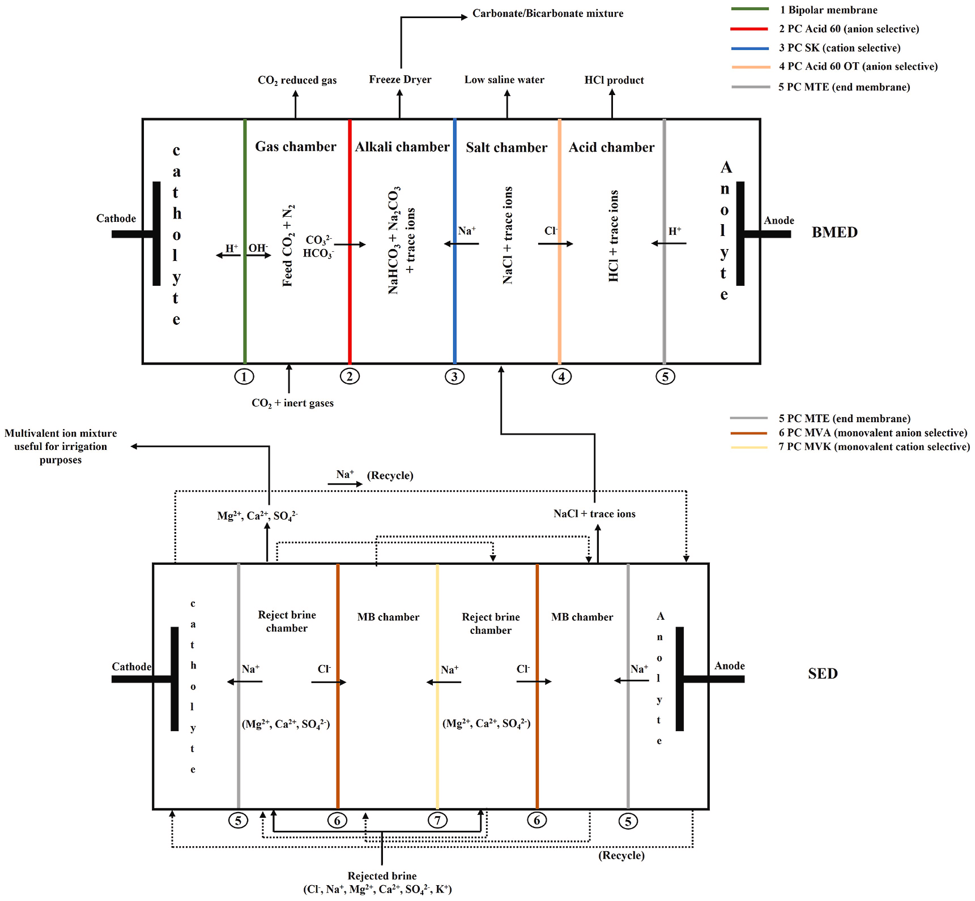
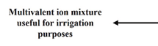


Experimental Setup
Next stage: BMED
SED
Repeating unit
20 cell pairs max.
20 MAEM
19 MCEM
2 ECEM
Electrolyte
Aminosulfonic acid
Current density = 109 A/m²
Cell pairs = 20
Diluent/concentrate flow rate = 15 L/h
Electrolyte flow rate = 72.91 L/h
monovalent
ion-concentrated
brine
Notes:
The SED stack consists of two chambers: a waste brine chamber (dilute chamber) and a monovalent ion concentrated brine (MB) chamber (concentrate chamber). Repeating unit is 20. In each repeating unit, there is one MAEM and MCEM. The ECEM are designed to withstand high transmembrane pressures, making them suitable for use at the ends of the stack.
Amino sulfonic acid was chosen as the electrolyte to mitigate scaling in the electrolyte chamber due to the presence of divalent ions in the waste brine. Over time, these divalent ions may leak into the electrolyte chamber, causing scaling or precipitation. To avoid this problem, amino sulfonic acid is considered an effective electrolyte to remove metal oxide deposits from metal and ceramic surfaces. And it is considered to be relatively more environmentally friendly and less toxic as an electrolyte for cleaning metal surfaces

Slide 9
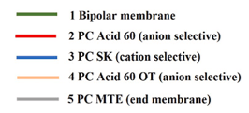

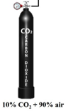
Experimental Setup
Repeating unit
BMED
5 cell pairs max.
5 BPM
5 AEMs (PC Acid 60)
5 AEMs (PC Acid 60 OT)
5 CEMs
1 ECEM
Gas
10% CO₂ and 90% air
Selective removal of sulfur oxides (SO_{x}), nitrogen oxides (NO_{x}), and organic anions
Current density = 47 A/m²
Cell pairs = 5
CO₂ flow rate = 0.3 L/min
10% CO₂+ 90% air
Notes:
The BMED stack consists of four chambers: gas, salt, base, and acid chambers. The BMED can accommodate up to five cell pairs and two electrolyte cells. The BMED stack consists of five bipolar membranes (PC BP), five AEMs (PC Acid 60), five AEMs (PC Acid 60 OT), five CEMs (PC SK), and one ECEM. The BMED stack has the ECEM at one end and the bipolar membrane at the other end.
They utilized a synthesis gas mixture that included 10% CO2 and 90% air (mostly N 2 ) in the proposed process. The alkali chamber, acid chamber, and gas chamber are supplied with NaHCO3, HCl, and Na 2 CO 3 dissolved in distilled water, respectively.

Slide 10
CONTENT
Background
Experimental Setup
Treatment in SED
Valorization through BMED
Economic Analysis

Slide 11
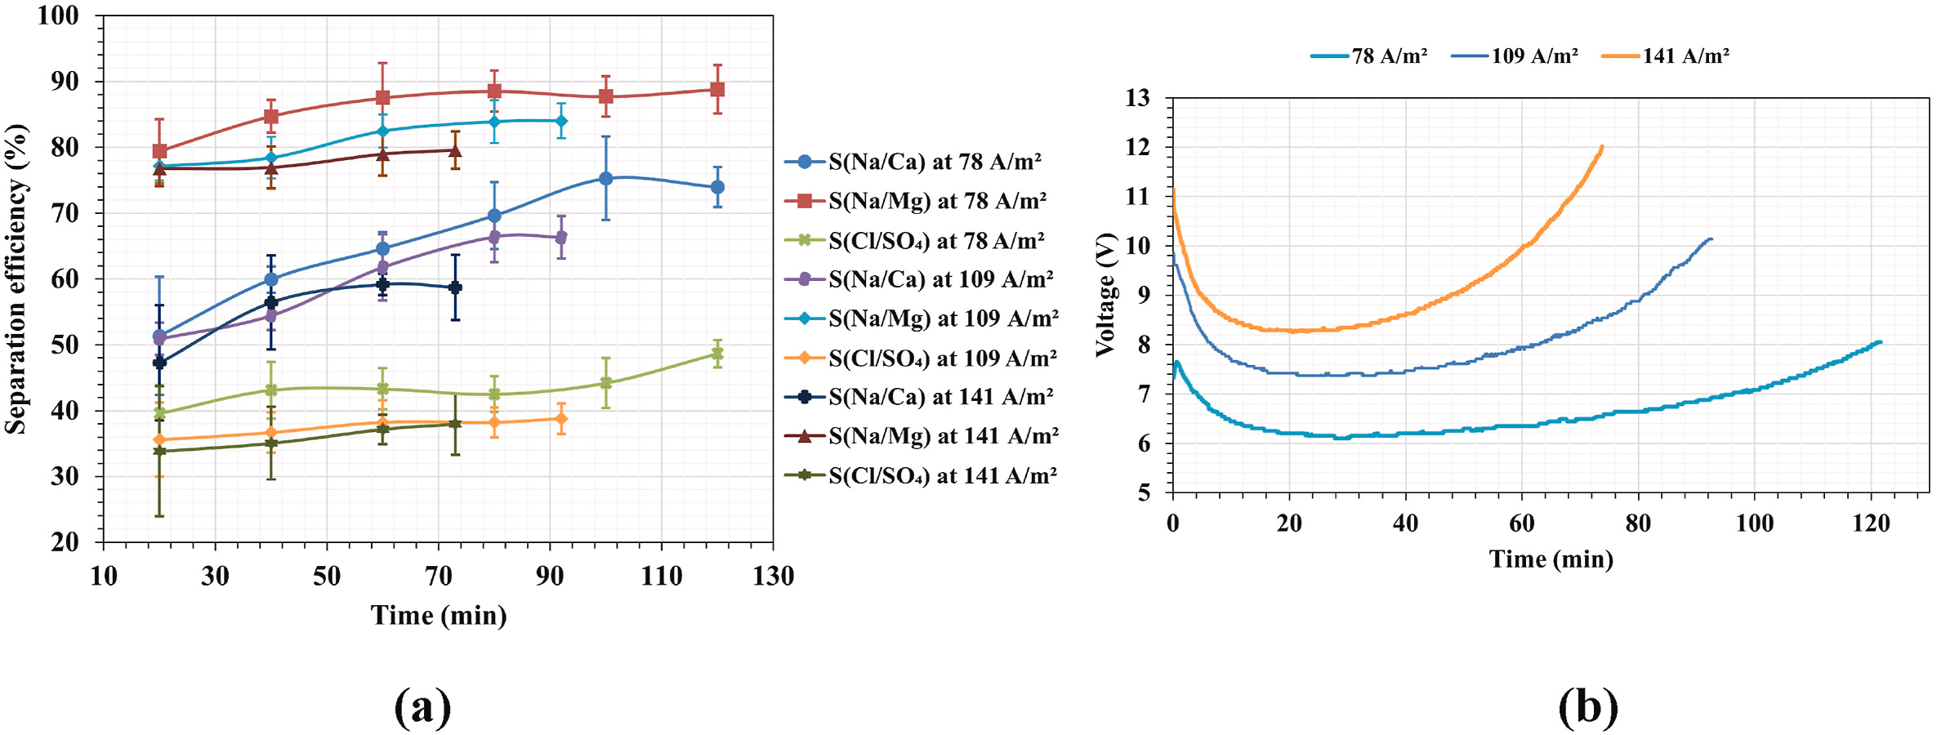
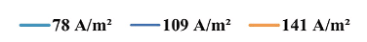
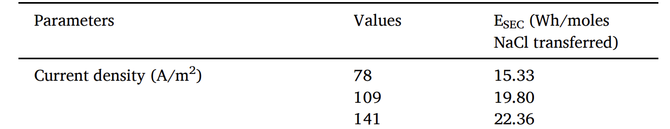
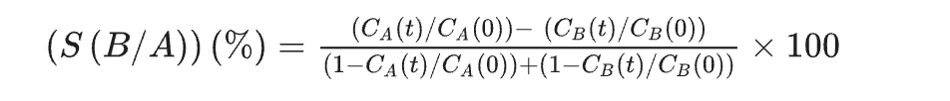
Treatment in SED —— Effect of current density
(a)
(b)
S(Na/Mg)
S(Na/Ca)
(c)
Fig. The effect of current density on (a) S(Na/Ca), S(Na/Mg), and S(Cl/SO₄) over time, (b) voltage over time and (c) SEC with a constant reject brine/MB chamber flow rate of 15 L/h, an electrolyte flow rate of 72.91 L/h, and 20 cell pairs.
Na⁺ < Ca²⁺ < Mg²⁺
The hydrated radii of ions
Donnan exclusion effect
Selectivity of membranes
The separation of monovalent ions from divalent ions
Notes:
In SED, the most essential target is to separate divalent ions and monovalent ions. They measure the separation efficiency and voltage change and EC in the process.
Among all current densities, Mg2+ has the highest separation efficiency than Ca2+. Initially, the separation efficiency is low due to the low presence of Na+ and Cl− in the concentrate chamber, but it increases as more ions enter. Increasing the current density reduce the process time but reduces the separation efficiency. In ED, it was found that lower applied current density preferentially removes divalent ions. Three key parameters affect the ion separation efficiency: the hydration radius of the ion, the Donnan exclusion effect and the selectivity of the membrane. The hydration radius of cations increases in the following order. Ions have larger hydration radii, resulting in higher hydration free energy and requiring a larger driving force to cross the membrane compared to ions with smaller hydration radii. At high current densities, more ions (both monovalent and divalent) are able to permeate through the membrane. As a result, the difference between monovalent and divalent ions decreases, resulting in a lower separation efficiency. Therefore, in the present case of SED, a smaller driving force (low current density) is beneficial for achieving high separation efficiency. However, it is crucial to consider the total resistance when determining the minimum current density. At very low current densities, the osmotic pressure can become significant and can hinder the process.
In Figure b the required voltage increases with increasing current density. Initially, the resistance is large due to the low ion concentration in the MB chamber. the subsequent voltage increase indicates the depletion of Na + and Cl − from the waste brine chamber.
SEC increases with increasing current density, as shown in Table 3

Slide 12
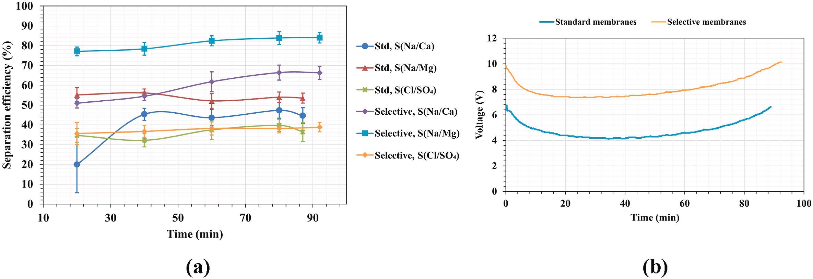
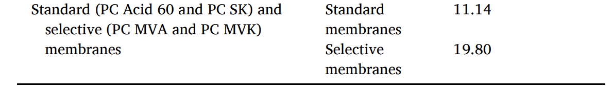
Treatment in SED —— Effect of CEMs
(a)
(b)
S(Na/Mg) = 54 % → 84 %
S(Na/Ca) = 45 % → 66 %
(c)
Fig. A comparison between standard and selective membranes: (a) S(Na/Ca), S(Na/Mg), and S(Cl/SO₄) over time, (b) Voltage over time, and (c) SEC, under constant operating conditions of 109 A/m2 current density, 20 cell pairs, a reject brine/MB chamber flow rate of 15 L/h, and an electrolyte flow rate of 72.91 L/h.
Notes:
The effect of membrane type (selective/standard) on separation efficiency is shown in Figure. When replacing standard membranes with selective membranes, the separation ratio of Mg increase from 54 % to 84 % and that of Ca increase from 45 % to 66 %.
The voltage variation with time for the selective membrane and the standard membrane is depicted in Figure b. Typically, selective membranes have higher resistance than non-selective membranes or standard membranes due to the additional polymer layer deposited on the base polymer surface. the area resistance of selective membrane is two to three orders of magnitude higher than the area resistance of the standard
It is worth noting that the energy consumption of standard membranes is significantly lower than that of selective membranes.

Slide 13
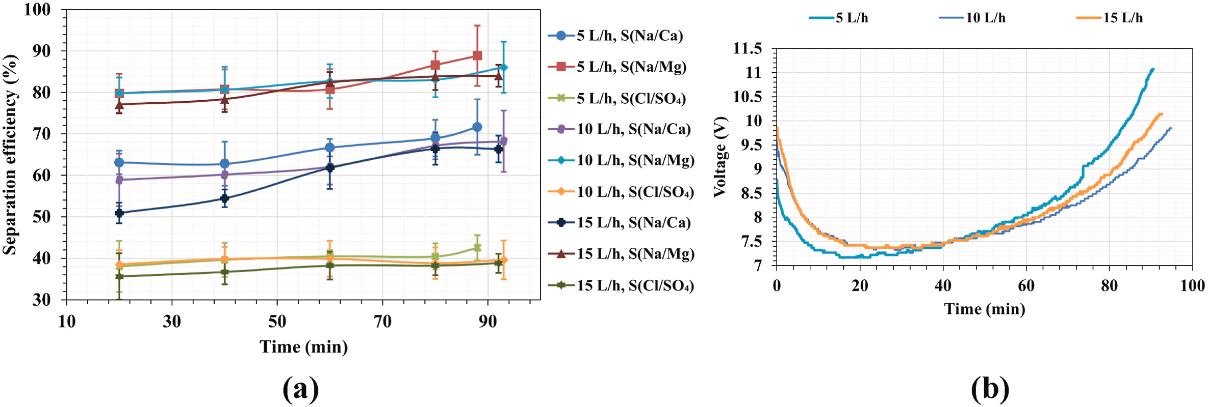
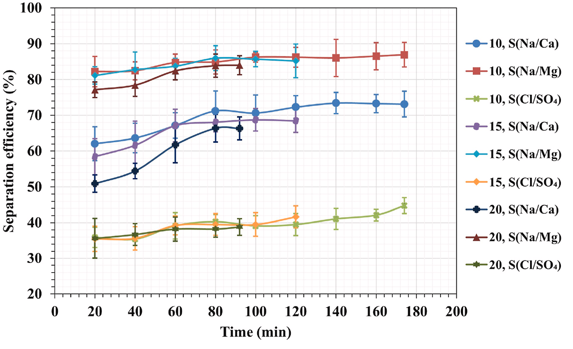
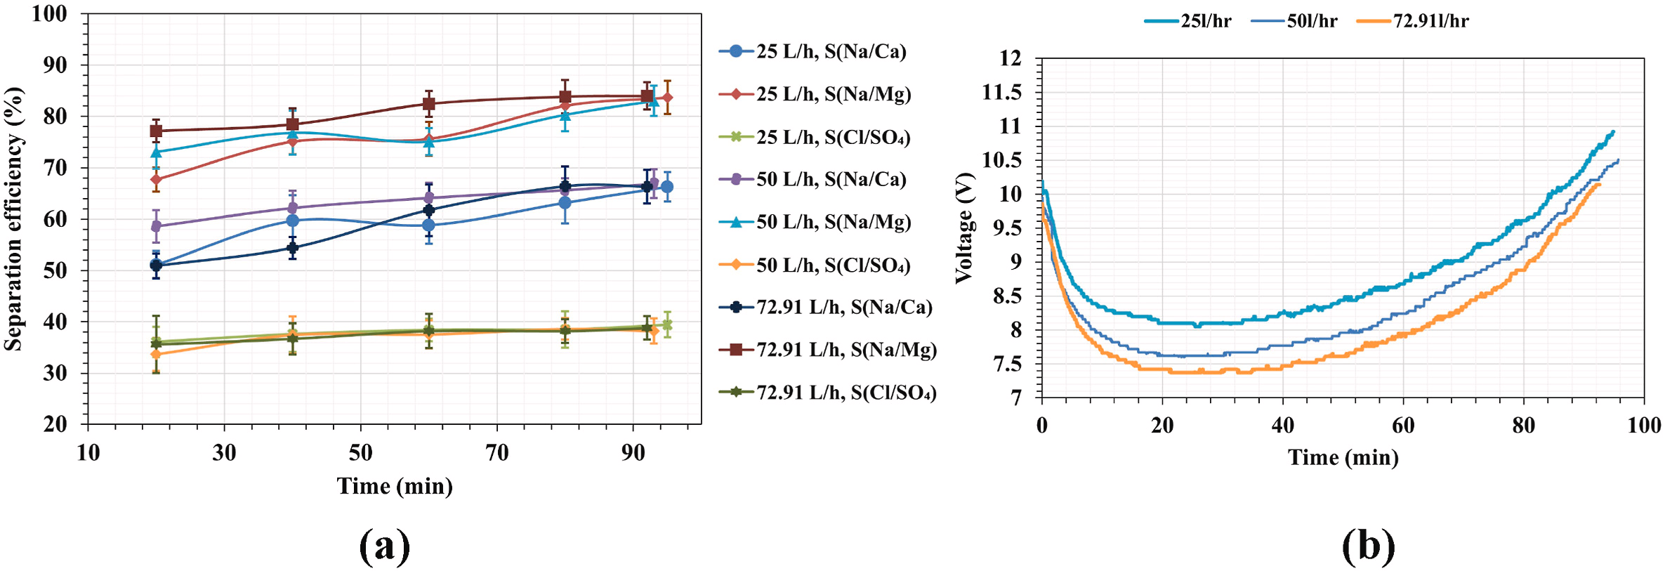
Treatment in SED —— Effect of feed flow rate, cell pairs, electrolyte flow rate
(a)
(b)
(c)
20
15
10
Fig. The effect of (a) reject brine/MB chamber flow rate (b) cell pairs and (c) electrolyte flow rate on selectivity over time
Notes:
They also measured the influence of feed flow rate, cell pairs and electrolyte flow rate. The influence of them is not significant compared to the current density and membrane types.
higher flow rates reducing the thickness of the diffusion boundary layer and increasing the ion transfer rate. However, as flow rate increases, the separation of monovalent ions decreases, primarily due to increased leakage of divalent ions into the MB compartment.
The fewer cell pairs, the higher the separation efficiency. As the number of cell pairs increases, the membrane surface area increases, creating more opportunities for ions to interact with the membrane. This increase in interaction may result in more ions being transferred into the MB compartment.
High electrolyte flow rate had a positive effect on the removal of Mg 2+ and Ca 2+ during the first 80 min. However, the effect of electrolyte on the removal of Ca 2+ and Mg 2+ gradually decreased over time and almost disappeared when the conductivity of the spent brine chamber reached 30 mS/cm.

Slide 14
CONTENT
Background
Experimental Setup
Treatment in SED
Valorization through BMED
Economic Analysis

Slide 15
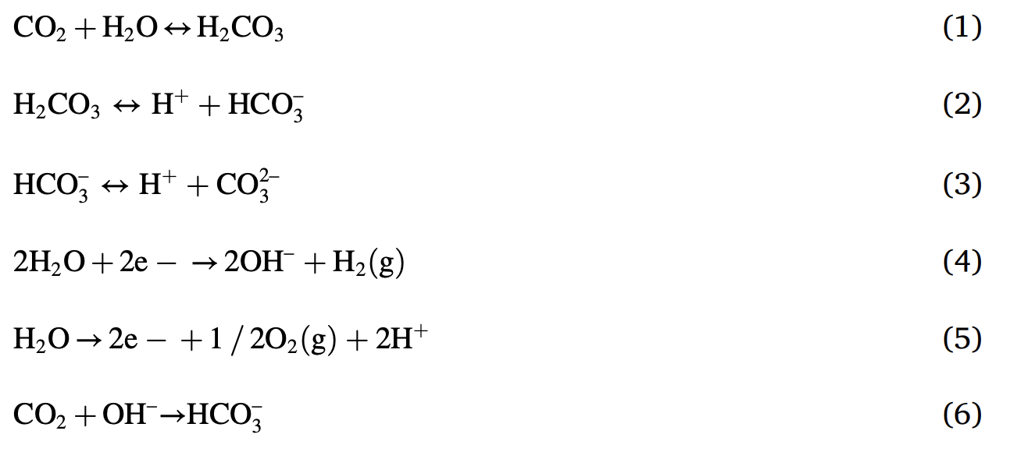
Valorization through BMED
+ Na⁺
Notes:
For BMED, it is essential to absorb more CO2. in the stack there are three equilibrium that needs to be considered. With the balance keeps to shifting to rightside, bicarbonate and carbonate ions will combine with sodium ions to form salt in base chamber.

Slide 16
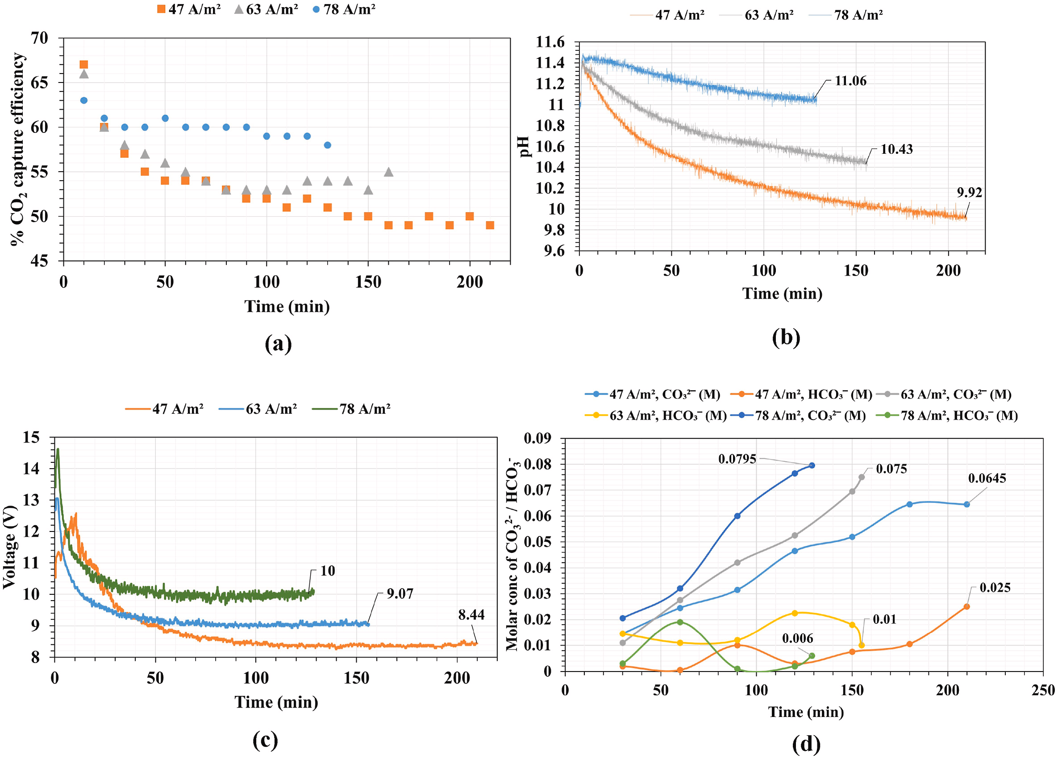
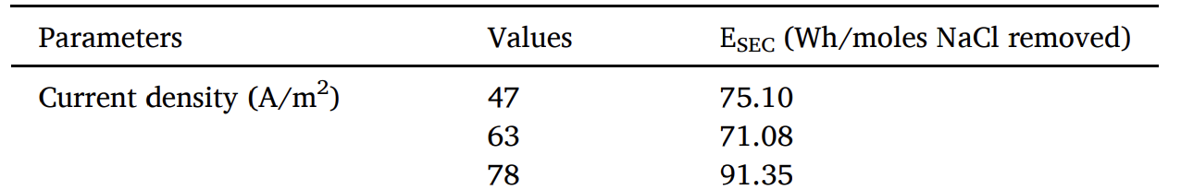
Valorization through BMED —— Effect of current density
(a)
(b)
(e)
58%
55%
49%
(c)
(d)
CO₃²⁻
↑
↑
HCO₃⁻
Fig. The effect of current density on (a) % CO₂ capture efficiency, (b) pH of gas chamber, (c) voltage and (d) molar concentration of CO₃²⁻/HCO₃⁻ in the alkali chamber over time (CO₂ flow rate = 0.3 L/min, cell pairs = 5). (e) SEC
Notes:
In BMED, they measure the influence on various parameters in the BMED system, including CO2 capture efficiency, gas chamber pH, molar concentration of CO32− /HCO3− in the base chamber, and voltage over time.
Increasing current density enhances CO 2 capture. The higher the current density in the bipolar membrane, the greater the amount of water decomposed into OH− and H+, thereby enhancing CO2 capture.
The increase in CO2 capture efficiency with increasing current density can also be observed from the pH vs. time curves Figure b. The pH in the gas chamber initially surges due to the presence of the Na2CO3 solution. Starting from 11.4, the pH drops as CO2 is absorbed, leading to the formation of carbonic acid. Carbonic acid dissociates to produce HCO3− and H+. Further dissociation of HCO3− can lead to the formation of CO32−
Shows the variation of voltage with time at different current densities. Increasing current density can decrease resistance
Higher current density leads to increased CO 2 absorption. This in turn increases the concentration of HCO 3 − and shifts the equilibrium of reaction 3 towards a higher proportion of CO 3 2−.
The energy consumption of the BMED system can be seen in the table.

Slide 17
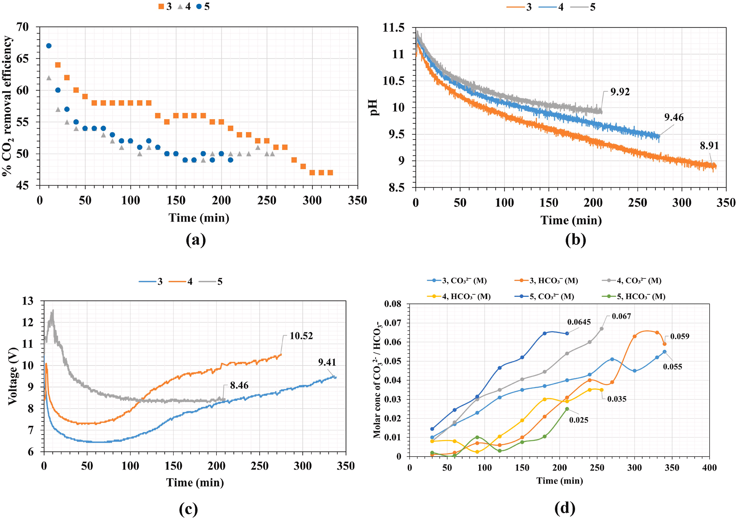
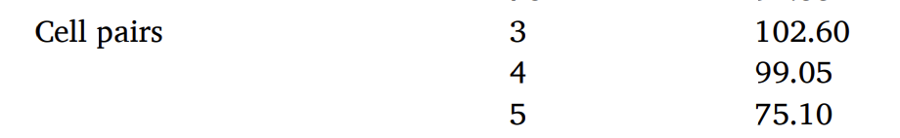
Valorization through BMED —— Effect of cell pairs
(a)
(b)
(e)
More Pairs
Accelerate process
(c)
(d)
More Na₂CO₃
CO₃²⁻
No HCO₃⁻/CO₃²⁻ equilibrium
HCO₃⁻
Cannot absorb CO₂
Fig. The effect of cell pairs on (a) % CO₂ capture efficiency, (b) pH of gas chamber, (c) voltage and (d) molar concentration of CO₃²⁻/HCO₃⁻ in the alkali chamber over time (CO₂ flow rate = 0.3 L/min, current density = 47 A/m²). (e) SEC
Notes:
Figure depicts the effect of cell pairs on several parameters in the BMED,
The increase in the number of cell pairs results in a larger effective membrane area and a faster drop in the salt chamber conductivity to final point. However, the decrease in bipolar membrane performance leads to a decrease in CO2 uptake. The utilization of Na2CO3 leads to a significant decrease in CO2 capture efficiency for all cell pairs.
The pH variation between different cell pairs is shown. It is noteworthy that the large decrease in pH values ​​may indicate an increase in the ability to capture CO2 and form carbonic acid. less irreversibility occurs in the lower cell pairs, resulting in a higher amount of CO2 captured.
The voltage changes over time between different cell pairs are depicted.
The changes in the HCO 3 − /CO 3 2− concentrations in the base chamber for different cell pairs are shown. Increasing the number of cell pairs results in a decrease in the HCO 3 − /CO 3 2− concentration, which is shown in Figure 8(a) due to irreversibility within the system. When the HCO 3 − concentration is high, the reaction shifts in the positive direction, resulting in an increase in the CO32− concentration, and vice versa.
Increasing the number of cell pairs results in a decrease in EC. In addition, the operating time is also reduced, thereby reducing the energy consumption.

Slide 18
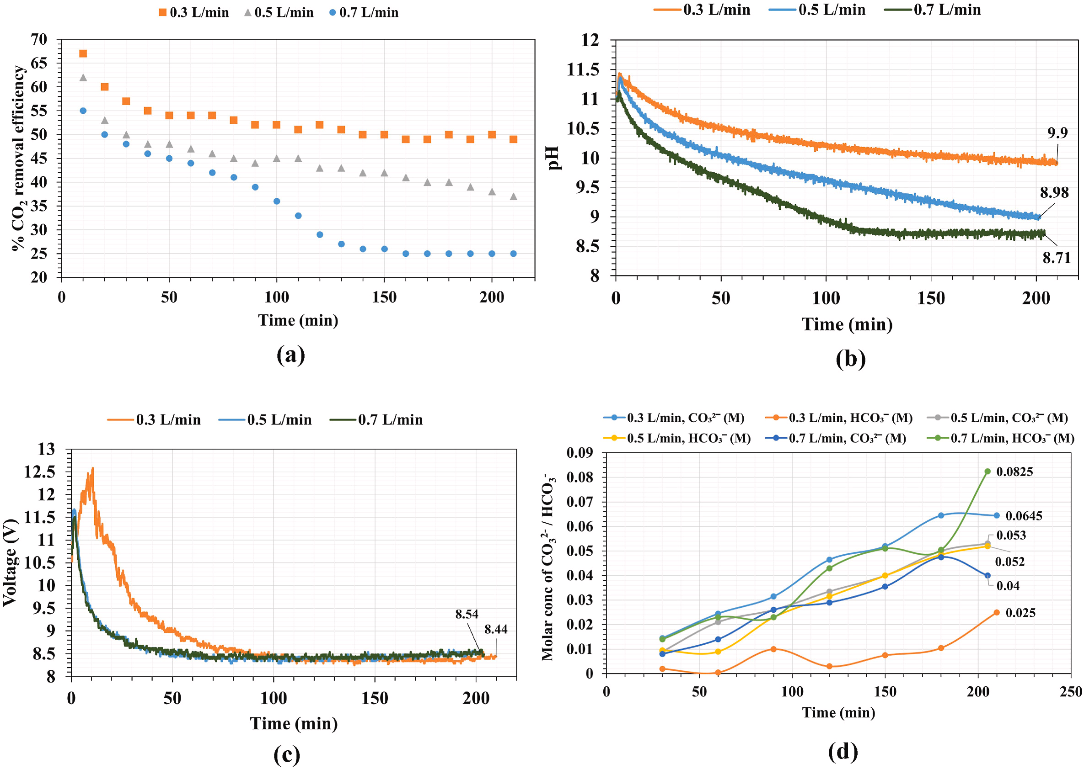
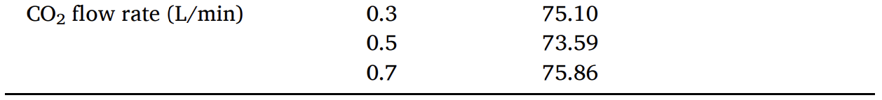
Valorization through BMED —— Effect of CO₂ flow rate
(a)
(b)
(e)
(c)
(d)
CO₃²⁻
HCO₃⁻
Fig. The effect of CO₂ flow rate on (a) % CO₂ capture efficiency, (b) pH of gas chamber, (c) voltage and (d) molar concentration of CO₃²⁻/HCO₃⁻ in the alkali chamber over time (current density = 47 A/m², cell pairs = 5). (e) SEC
Notes:
Increasing CO 2 flow rate results in decreased CO 2 capture efficiency. Apparently, the gas chamber with a current density of 47 A/m 2 cannot produce enough OH − to handle the high CO 2 flow rate.
The pH versus time curve shows that the pH decreases with increasing CO 2 flow rate. As the CO 2 flow rate increases, the carbonic acid concentration also increases, leading to a decrease in pH.
The voltage is plotted as a function of CO 2 flow rate over time. The voltage stabilizes after an initial fluctuation and reaches a constant value. Low ionic strength and low gas solubility initially cause the resistance to increase at 0.3 L/min CO 2 flow rate, but the resistance gradually returns to normal after 100 min.
shows the variation of HCO3−/CO32− ion concentration in the base chamber with CO2 flow rate. The higher the CO 2 flow rate, the greater the HCO 3 − /CO 3 2− ion flux in the base chamber, resulting in a higher HCO 3 − /CO 3 2− concentration. Therefore, the high CO 2 flow rate shifts the equilibrium toward HCO 3 − formation.
(e) SEC is relatively unaffected by changes in CO 2 flow rate, see Table for details.

Slide 19
CONTENT
Background
Experimental Setup
Treatment in SED
Valorization through BMED
Economic Analysis

Slide 20
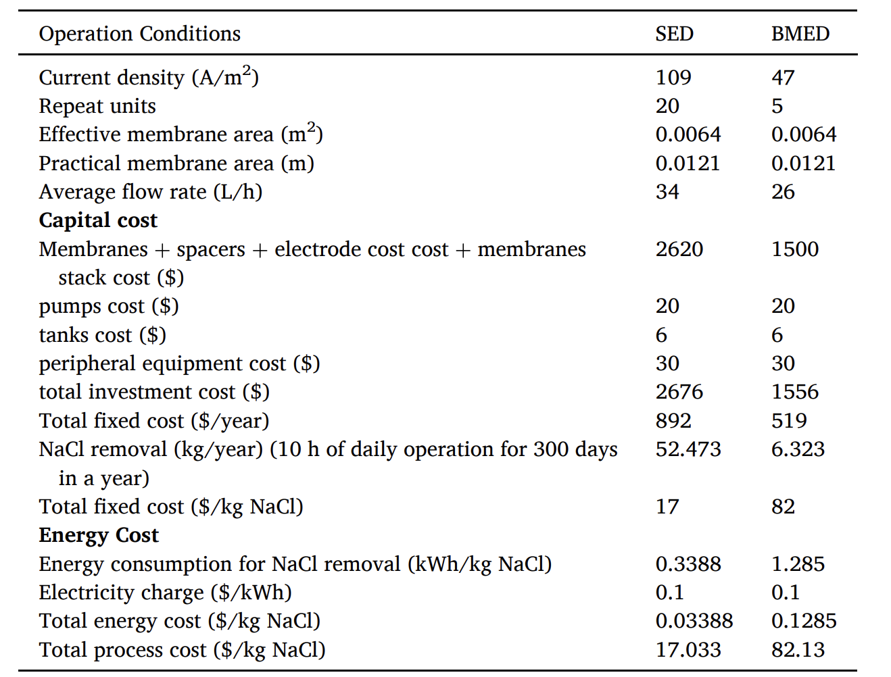
Economic Analysis
Table. Cost estimation of SED and BMED.
Optimal parameters
Notes:
Preliminary cost estimates of SED and BMED under optimal conditions. The expected service life of SED and BMED membranes, membrane stacks and related equipment is approximately three years.
A major bottleneck for SEDs and BMEDs ​​has been the substantial expense associated with ion exchange membranes (especially bipolar membranes); therefore, cost reduction strategies focused on optimizing membrane expenses and their efficient utilization can play a key role in overall cost reduction. The integration of SED and BMED technologies has the dual advantages of cost-effectiveness and environmental sustainability, and is a promising avenue to explore. It is worth mentioning that the by-products of this process, including Na2CO3 /NaHCO3 , HCl and irrigation standard water, have not been included in the economic analysis of this process. Part of the process costs can be offset by revenue generated from the sale or industrial utilization of these valuable by-products.

Slide 21
Conclusion
Effective integration of SED and BMED processes
Efficient treatment of brine for disposal or reuse
CO₂ capture
Recovery of valuable byproducts: high purity HCl, Na₂CO₃/NaHCO₃ salts, irrigation standard water, and 93% pure NaCl solution
SED → S(Na/Ca) = 59%~74%, S(Na/Mg) = 80%~89%
BMED → CO₂ capture efficiency = 25%~50%

Slide 22
Reference
Boettcher, M., Brent, K., Buck, H. J., Low, S., McLaren, D., & Mengis, N. (2021). Navigating potential hype and opportunity in governing marine carbon removal. Frontiers in climate, 3, 664456.
Do Thi, H. T., Pasztor, T., Fozer, D., Manenti, F., & Toth, A. J. (2021). Comparison of desalination technologies using renewable energy sources with life cycle, PESTLE, and multi-criteria decision analyses. Water, 13(21), 3023.
Jones, E., Qadir, M., van Vliet, M. T., Smakhtin, V., & Kang, S. M. (2019). The state of desalination and brine production: A global outlook. Science of the Total Environment, 657, 1343-1356.
Zhongming, Z., Linong, L., Xiaona, Y., Wangqiang, Z., & Wei, L. (2019). UN warns of rising levels of toxic brine as desalination plants meet growing water needs.

Slide 23
Thank You For Listening
Speaker: Ni Yuqin
22 NOV 2024

